Slide 1
Capstone Project
Credit Card Default Prediction Submitted by Samara Reddy (Individual)

Slide 2
Content
Introduction
Data summary
Factors
Cleaning Dataset
Exploratory data analysis
Algorithms Used
Conclusions

Slide 3
Introduction:
In this project I had used the dataset that consists of 30,000
credit card usage records with 25 columns and used 4 machine learning models - Logistic Regression, Decision Tree, Random Forest and Gradient Boosting.
Credit risk has traditionally the greatest risk among all the risks that the banking and credit card industries are facing.
The main objective of this project is to conduct quantitative analysis on credit card default by using the machine learning models with accessible customer data.

Slide 4
Data summary
The dataset contain following columns :
X1: Amount of credit for both the individual and his/her family credit.
X2: Gender (1 = male; 2 = female).
X3: Education (1-graduate school, 2-university, 3-high school, 4- others)
X4: Marital status (1 = married; 2 = single; 3 = others).
X5: Age (year).
X6 = the repayment status in September
X7 = the repayment status in August,
X11 = the repayment status. 1-pay duly, 1-payment delay for 1 month, 2-payment delay for 2 months, likewise 9- payment delay for 9months & above.
X12 to X17 = amount of bill statement in various months
X18 to X23 = amount paid in various months

Slide 5
Factors
Following are the factors affecting to the default payment next month or our target variable:
Gender
Education
Age
Marital Status
Credit Limit
Inactive Customers

Slide 6
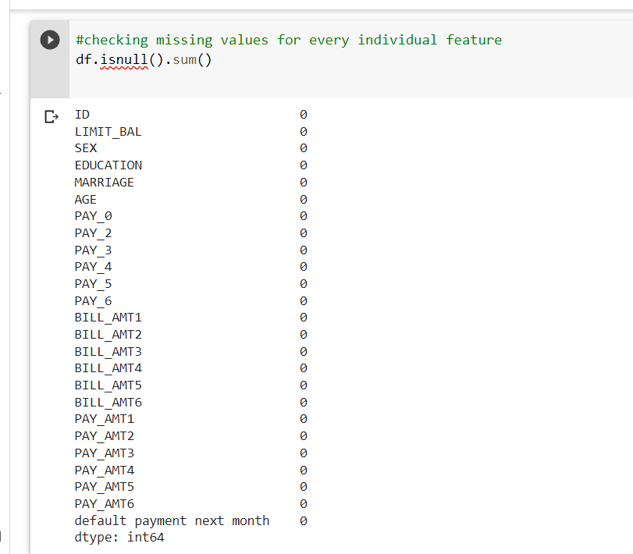
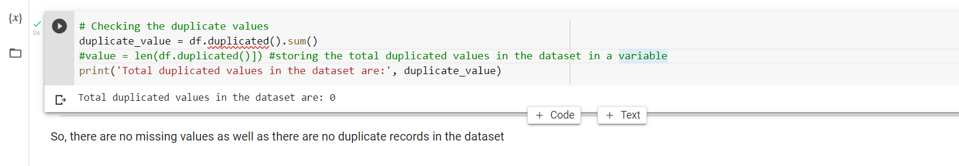
Cleaning of dataset (Null Values & Duplicate Values)
No Null Values and No Duplicate Values

Slide 7
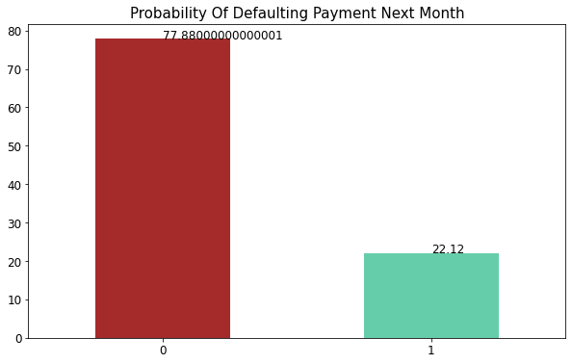
Data Visualization
There is a huge difference between both classes so we have to work on this class imbalance.
About 22% people are expected to default next month and 77.8% are not expected to default

Slide 8
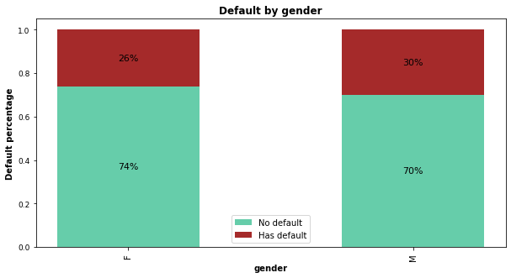
Data Visualization
The rate of being defaulter is comparatively higher in males with 30% of total defaulters than to 26% of female defaulter respectively.

Slide 9
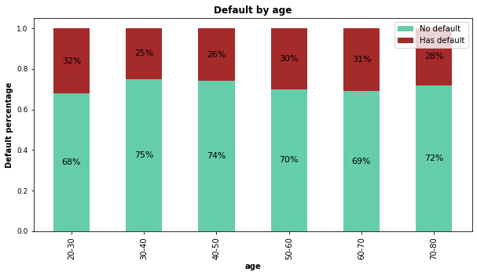
Customers aged between 30-50 had the lowest delayed payment rate, while younger groups (20-30) and older groups (50-70) all had higher delayed payment rates. However, the delayed rate dropped slightly again in customers older than 70 years.

Slide 10
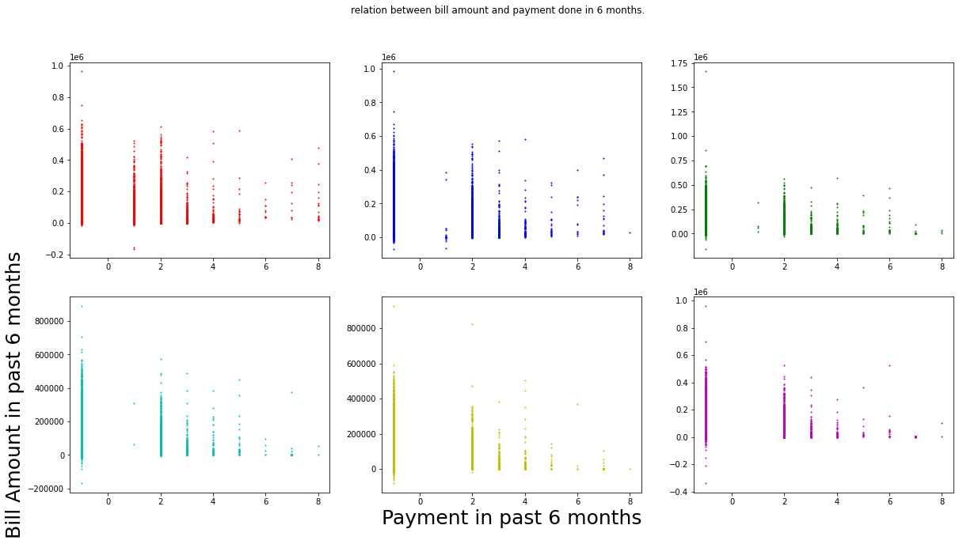
Data Visualization.
Above plot indicates presence of higher proportion of customers with higher bill amount but lower payment rate suggesting they are likely to do the fault. This we can infer since maximum of data points are closely packed along the Y-axis near to 0 on X-axis

Slide 11
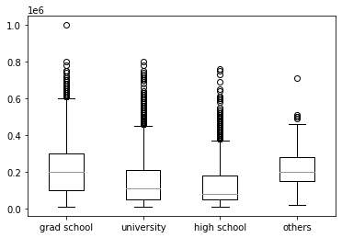
Data Visualization
Using boxplot to visualize credit limit grouped by education level
From the boxplot, it is clear that customers with grad school education have the highest median and highest maximum number, so we can say that people with higher education levels did get higher credit limits.

Slide 12
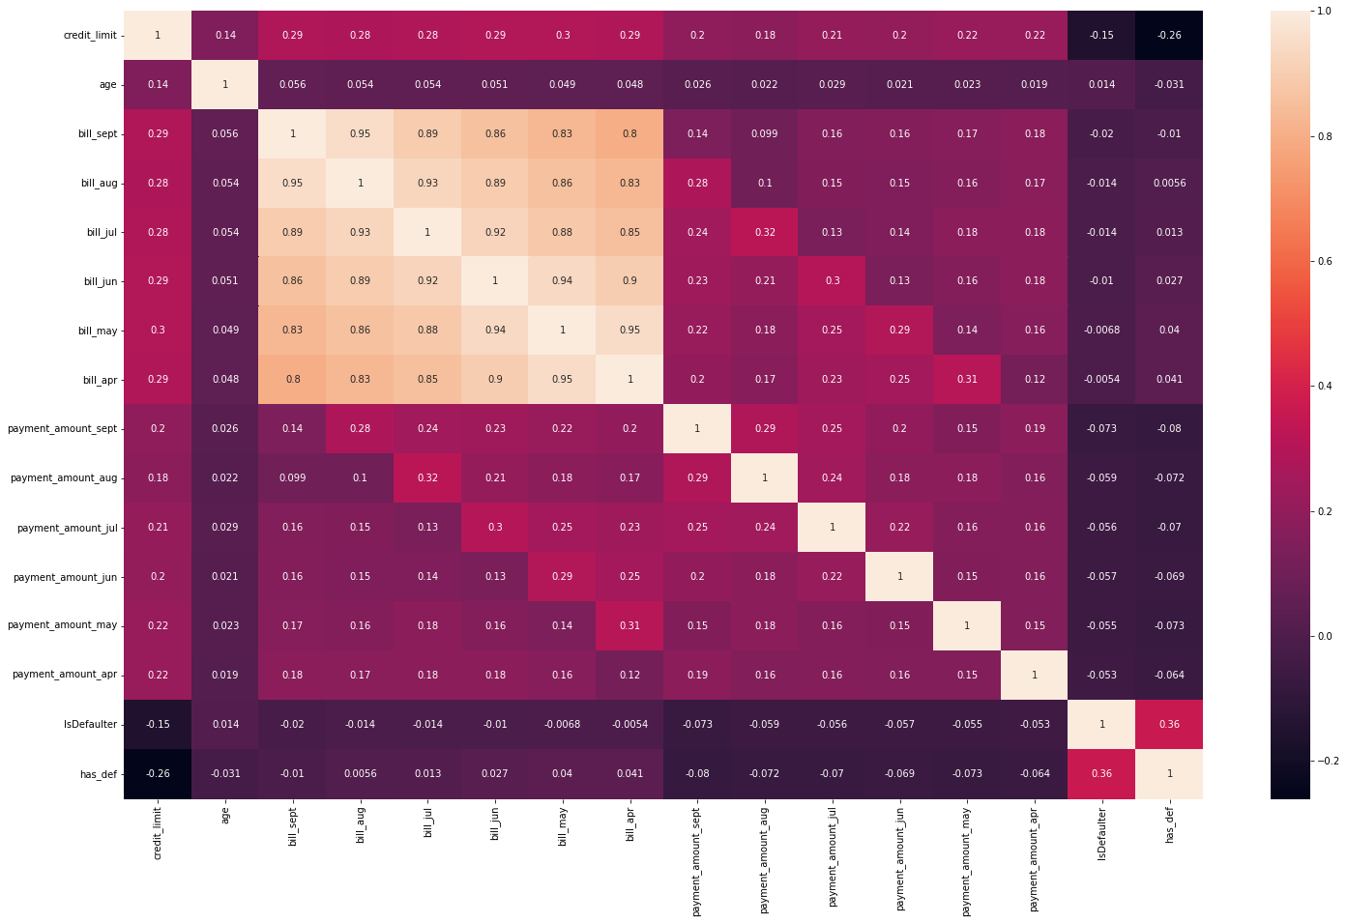
EDA - Correlation

Slide 13
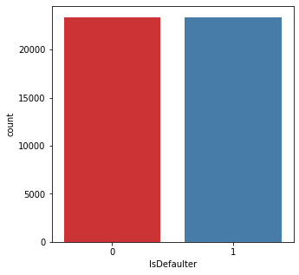
Handling Imbalanced Dataset
Handled Imbalanced dataset by using SMOTE technique
Before SMOTE After SMOTE

Slide 14
Algorithms used
Logistic Regression
Decision Tree
Random Forest
Gradient Boosting

Slide 15
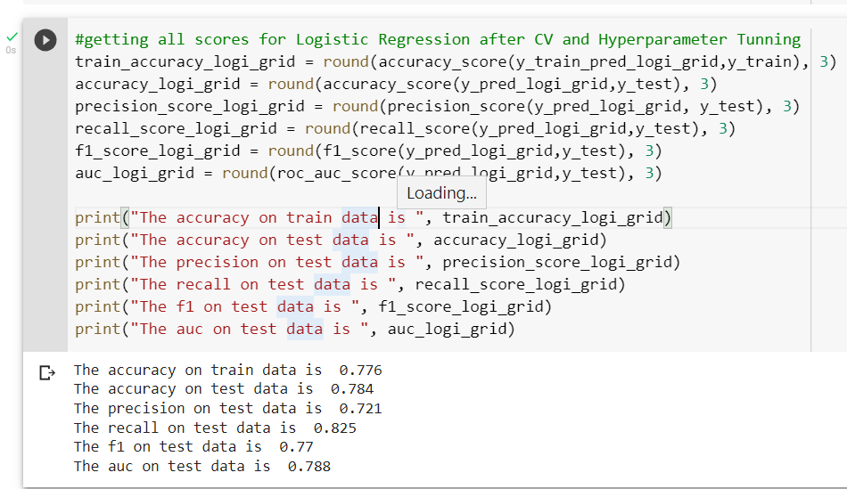
Logistic Regression Model
Hyperparameter
C | 0.0001
'max_iter' | 100
'penalty' | 'none'

Slide 16
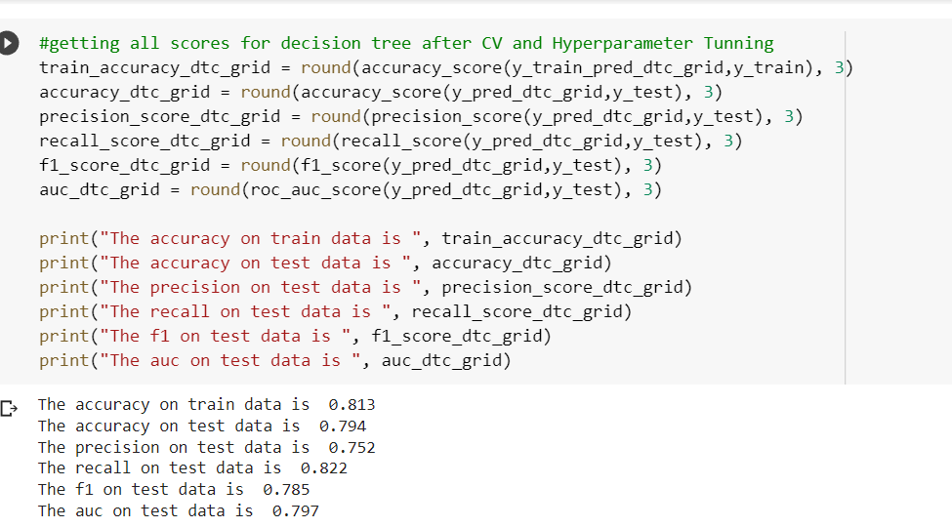
Decision Tree
Hyperparameter
max_depth | 25
'min_samples_leaf': | 60
'min_samples_split': | 0.001

Slide 17
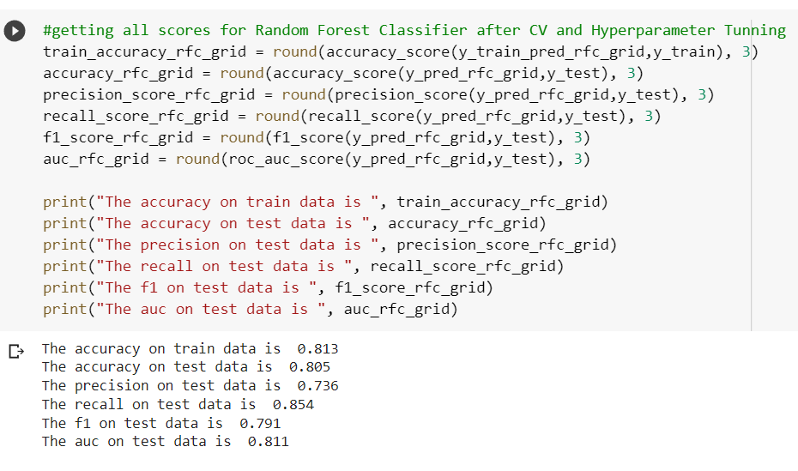
Random Forest
Hyperparameter
'max_depth’ | 30
'min_samples_leaf | 40
'min_samples_split | 50
n_estimators | 200

Slide 18
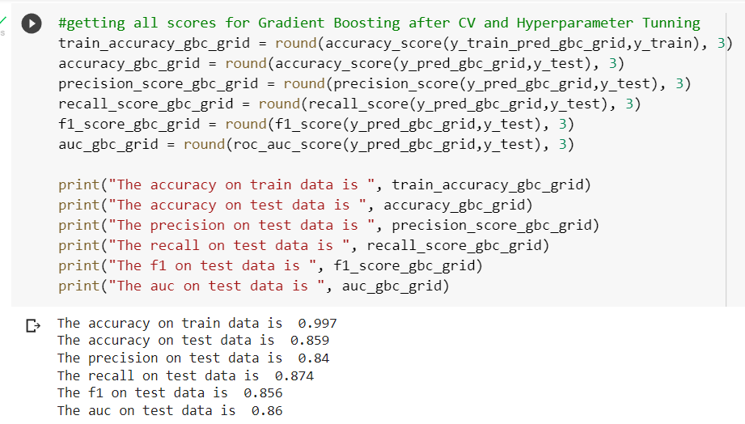
Gradient Boosting Algorithm
Hyperparameter
n_estimators | 200
min_samples_split | 50
min_samples_leaf | 40
max_depth | 20
learning_rate | 0.5

Slide 19
Conclusion:
No Null Values and No Duplicate Values in dataset
About 22% people are expected to default next month and 77.8% are not expected to default
The rate of being defaulter is comparatively higher in males with 30% of total defaulters than to 26% of female defaulter respectively.
Customers aged between 30-50 had the lowest delayed payment rate, while younger groups (20-30) and older groups (50-70) all had higher delayed payment rates.
Higher proportion of customers with higher bill amount but lower payment rate suggesting they are likely to do the fault
Customers with grad school education have the highest median and highest maximum number, so we can say that people with higher education levels did get higher credit limits
Gradient Boosting was high F1 score of 0.85 and Recall of 0.88
Random forest has high Recall of 0.88

Slide 20


